Slide 1
Road Accident Severity Classification Using US Accidents Dataset
Project for CSE 5523: Machine Learning and Statistical Pattern Recognition
Team Members:
Yuvraj Singh
Abdirashid Dahir

Slide 2
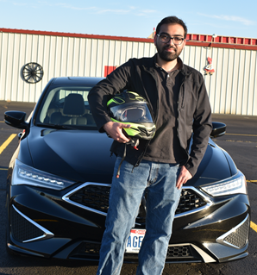

Team Introduction
Yuvraj Singh
Second Year PhD Student at OSU Center for Automotive Research
Abdirashid Dahir
First Year PhD Student at OSU Department of Geography

Slide 3
Content
Dataset Description
Base model from literature: Logistic Regression
Why did we use confusion matrices for model evaluation?
Classification performance metrics: user/producer accuracy, kappa coefficient
Feature selection and training data sampling
Correlation with target variable
Mutual Information
Algorithms
Logistic Regression (Base model)
Random Forest with Bootstrap Aggregation
Random Forest with Adaptive Boosting
Perceptron: One vs All and One vs One
Support Vector Machines: One vs All and One vs One
Neural Networks: fully connected multi-layer neural networks
Future Work
Binomial significance tests for new models vs base model
Model accuracy credible intervals
Cross-Validation: K-Fold, Monte-Carlo

